Slide 1



Sales Performance Overview
Presented by:
Nurudeen Ogunwole

Slide 2
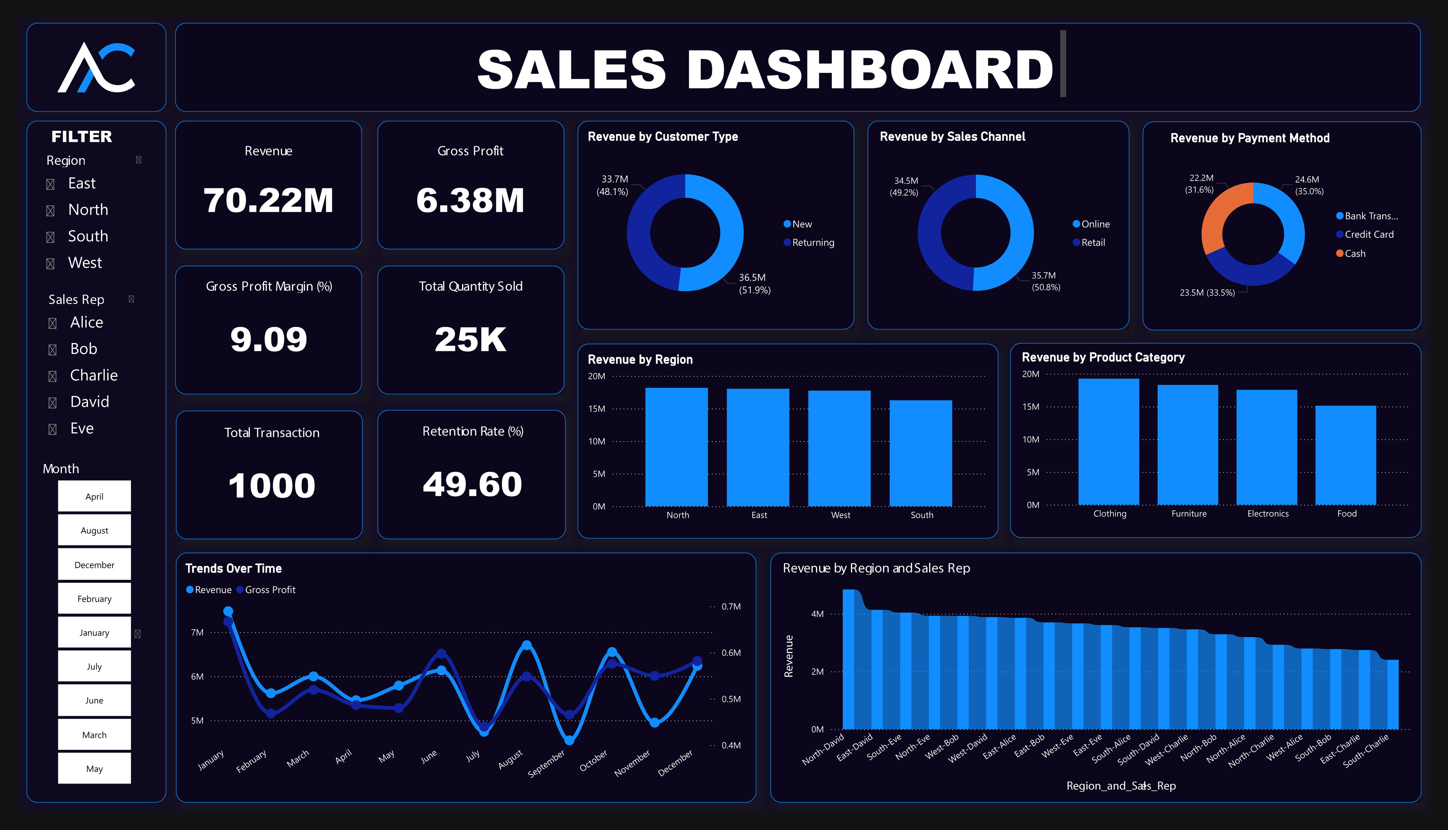
Executive Summary
Total Revenue: $70.22M
Gross Profit: $6.38M (9.09% margin)
Total Transactions: 1,000
Retention Rate: 49.6%
High Performance in Retail, Returning Customers, and the West/North Regions
Performance is strong, but retention and certain regions require strategic focus for scalable growth.

Slide 3
Monthly Revenue Trends
January delivered the highest revenue, exceeding $7M—an exceptional start to the year
October slightly outperformed December, both falling within the $6M–$7M range
August also ranked among the top-performing months, indicating mid year demand peaks
July and September showed the lowest revenue, signaling off season lulls

Slide 4
Regional Sales Performance
All four regions generated $15M–$20M in revenue, with no clear underperformer
North leads with approximately $19M, showing strong market demand
West follows closely at around $18M+, with similar sales strength
East contributes an estimated $17M, showing solid mid-tier performance
South, while slightly behind, still exceeds $15M, indicating stable potential

Slide 5
Sales by Product Category
All product categories generated revenue between $15M and $20M.
Clothing is the top performer, nearing the ₦20M mark
Furniture follows closely, just under $18M.
Electronics and Food trail slightly, but both remain above $15M.
Indicates a well balanced product portfolio with strong cross-category appeal

Slide 6
Revenue by Customer Type
New customers accounted for $36.5M (51.9%)
Returning customers contributed $33.7M (48.1%)
Revenue distribution is nearly equal, showing balance between loyalty and acquisition
Indicates strong customer retention alongside effective outreach and onboarding

Slide 7
Revenue by Sales Channel
Online channel leads with $35.7M (50.8%)
Retail channel follows with $34.5M (49.2%)
Performance split is fairly balanced, with a slight edge toward digital
Indicates strong online traction, supported by a resilient retail presence

Slide 8
Payment Method Insights
Bank Transfer leads slightly with $24.6M (35.0%)
Cash transactions follow closely at $23.5M (33.5%)
Credit Cards bring in $22.2M (31.6%)
Payment preferences are evenly distributed, with no method dominating
Indicates high payment flexibility and customer trust across options

Slide 9
Sales Rep Contributions by Region
David is the standout performer in North, East, and West, consistently hitting $3.5M+ in each
Eve generates high revenue in South, East, and West, matching or slightly trailing David
Bob has strong showings in North, West, and East, all in the $2.5M–$3.5M range
Alice and Charlie have more concentrated performance, with Alice notable in East and South, and Charlie showing in West and North
Overall, North and West have the highest collective revenue, driven by multiple high performing reps

Slide 10

Recommendations
Target January & October surges with focused campaigns
Strengthen East & South through local marketing initiatives
Formalize best practices from high-performing reps
Promote digital growth via loyalty, UX, and checkout upgrades
Offer payment incentives to match flexible customer preference

Slide 11

Conclusion
Business performance is balanced across all key metrics
Regional and seasonal insights highlight targeted growth areas
Online traction and high rep performance are momentum drivers
Future success lies in optimization, not reinvention

